Slide 1
Fake News Project
Prepared by
SARTHAK GUPTA

Slide 2
Agenda
Introduction​
Problem Statement
Business Goal
Technical Requirement
Exploratory Data Analysis (EDA)
Data Description
Visualization
Data Pre- Processing
Build Model
Saved Best Model
Summary​

Slide 3
Introduction
Fake news's simple meaning is to incorporate information that leads people to the wrong path. Nowadays fake news spreading like water and people share this information without verifying it. This is often done to further or impose certain ideas and is often achieved with political agendas. For media outlets, the ability to attract viewers to their websites is necessary to generate online advertising revenue. So it is necessary to detect fake news.

Slide 4
Business Goal
Fake news has become one of the biggest problems of our age. It has serious impact on our online as well as offline discourse. One can even go as far as saying that, to date, fake news poses a clear and present danger to western democracy and stability of the society.

Slide 5
Technical Requirements
We have We need to build a machine learning model. But before model building do all data preprocessing steps involving NLP. Try different models with different hyper parameters and select the best model.
There are two datasets one for fake news and one for true news. In true news, there is 21417 news, and in fake news, there is 23481 news. We have to insert one label column zero for fake news and one for true news. We have to combine both datasets using pandas built-in function.
Follow the complete life cycle of data science. Include all the steps like:
Data Cleaning
Exploratory Data Analysis
Data Preprocessing
Model Building
Model Evaluation
Selecting the best model

Slide 6
EDA
Top 5 rows of dataset
Checked Total Numbers of Rows and Column
Checked All Column Name
Checked Data Type of All Data
Checked for Null Values of both dataset
Added one more feature to distinguish between fake and true news by labelling
Merged both dataset
Dropped irrelevant features
Checked Information about Data

Slide 7
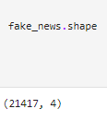
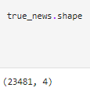
Data Description
The dataset contains 21417 records (rows) and 4 features (columns).
And after removal of irrelevant data and column, we remains with 23481 records (rows) and 4 features (columns).

Slide 8
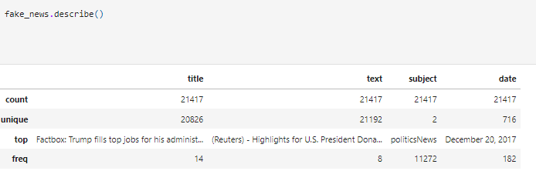
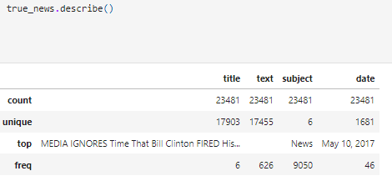
Data Description

Slide 9

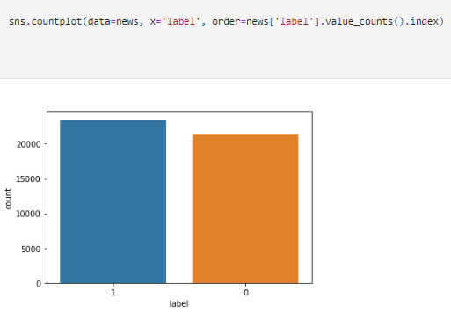
Data Visualization

Slide 10
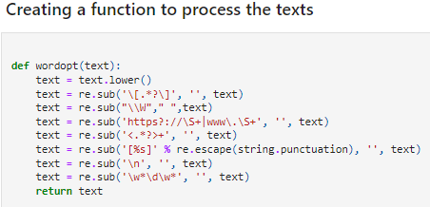
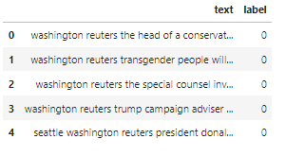


Data Pre- Processing

Slide 11


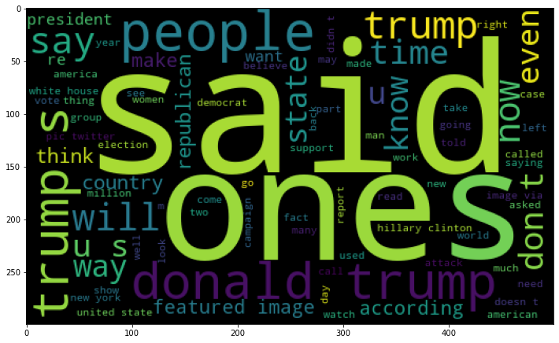
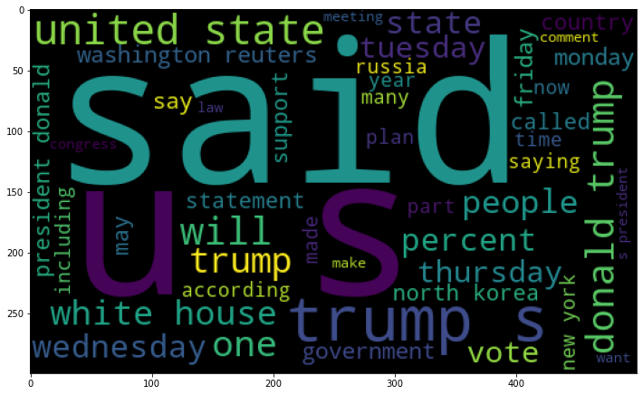
Word Cloud

Slide 12


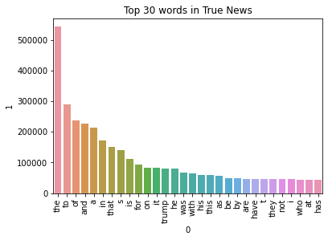
Word Cloud

Slide 13

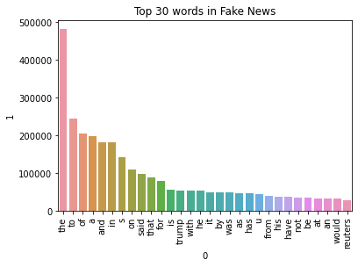
Word Cloud

Slide 14
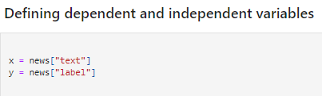
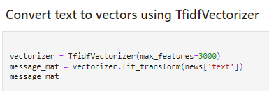



Slide 15
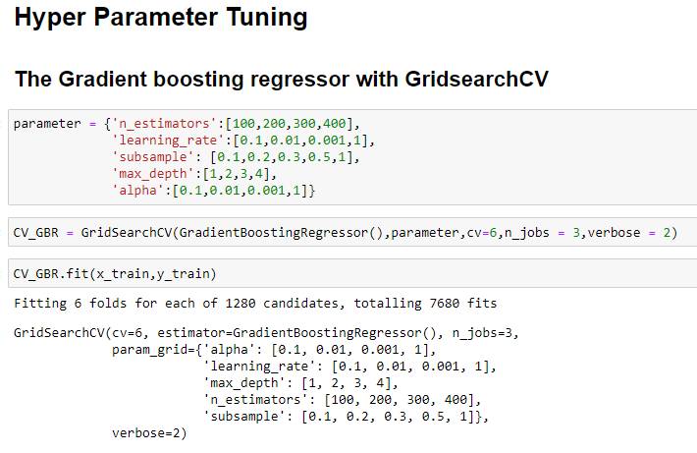
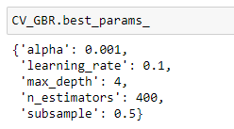
Hyper Parameter Tunning

Slide 16
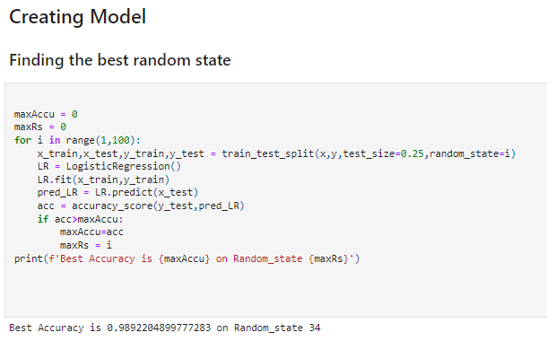
Algorithms Testing
Logistic Regression
Decision Tree Classifier
Gradient Boosting Classifier
Random Forest Classifier
Linear Support Vector Classifier
Bernoulli NB
Multinomial NB
SGD Classifier
LGBM Classifier
XGB Classifier

Slide 17
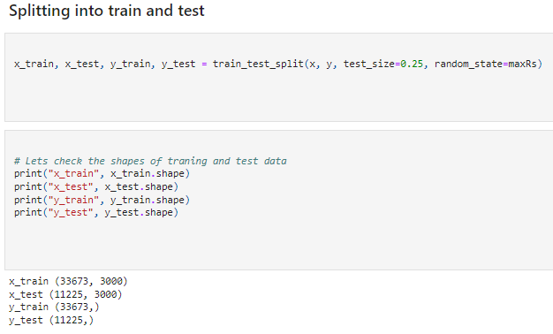
Algorithms Testing

Slide 18
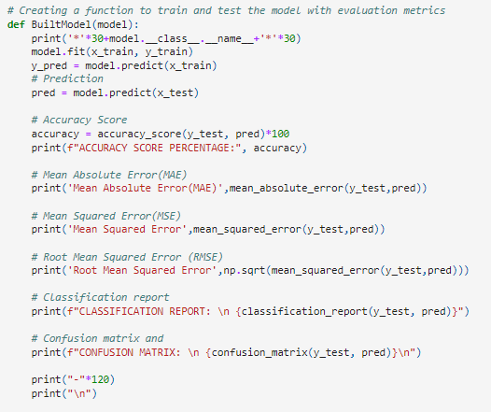
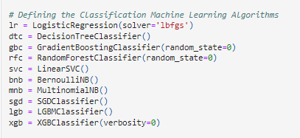
Algorithms Testing

Slide 19
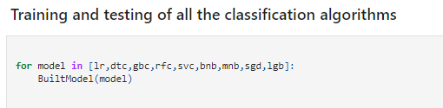
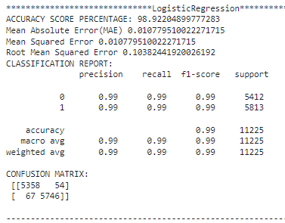
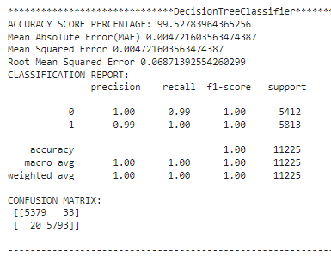
Algorithms Testing

Slide 20
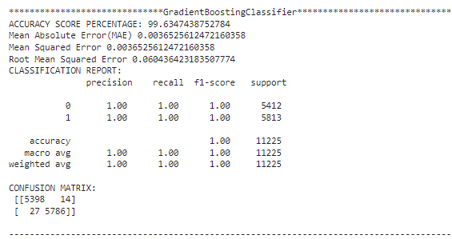
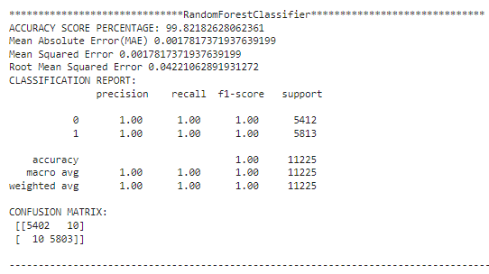
Algorithms Testing

Slide 21
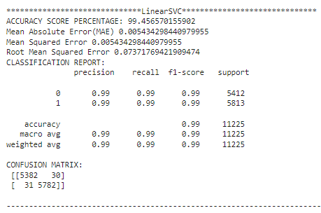
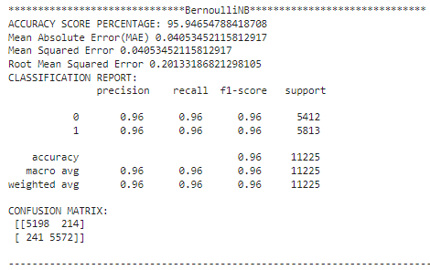
Algorithms Testing

Slide 22
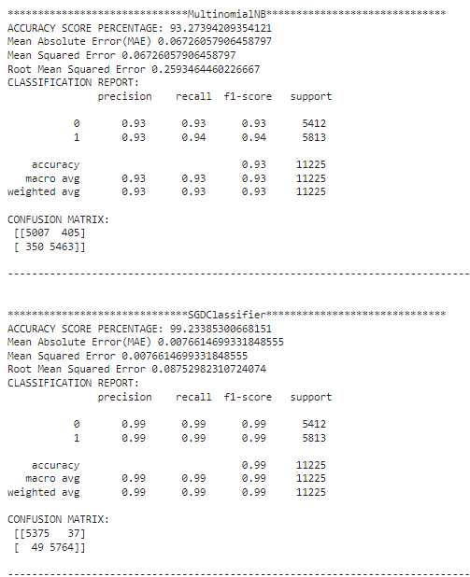
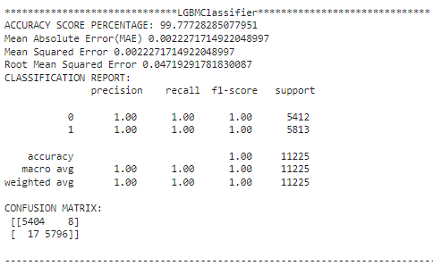
Algorithms Testing

Slide 23
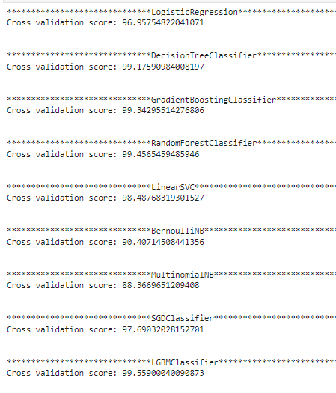
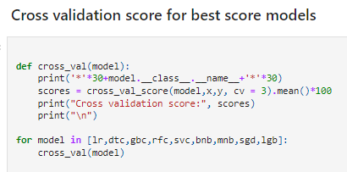
Cross Validation

Slide 24
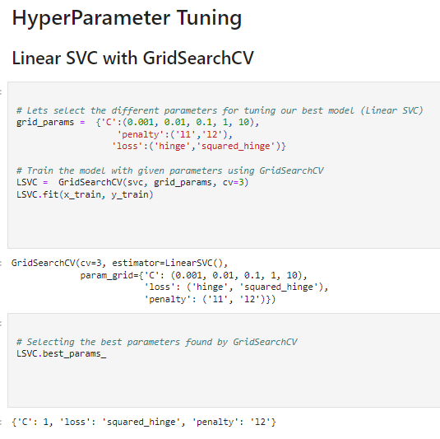
Hyper Parameter Tunning

Slide 25
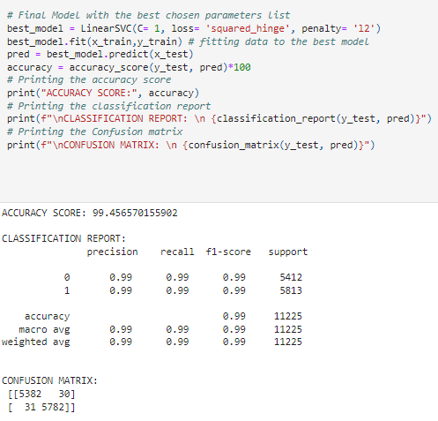
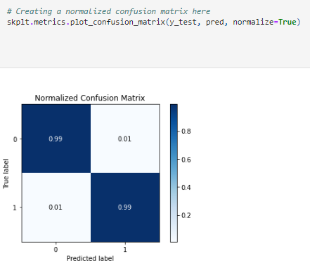
Hyper Parameter Tunning

Slide 26

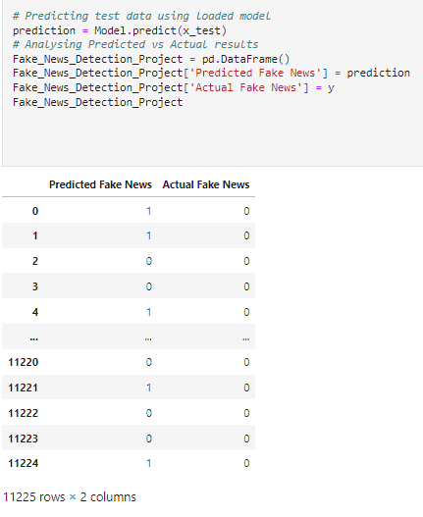
Final Steps
Saving the Model
Comparing Actual & Prediction

Slide 27

Saving model in CSV format

Slide 28
Summary
In this project we have detected which news are fake news and which are true news. Then we have done different text process to eliminate problem of imbalance. By doing different EDA steps we have analyzed the text.
We have checked frequently occurring words in our data as well as rarely occurring words. After all these steps we have built function to train and test different algorithms and using various evaluation metrics we have selected Linear-SVC for our final model.
Finally, by doing hyper parameter tuning we got optimum parameters for our final model. And finally, we got improved accuracy score for our final model.

